Slide 1
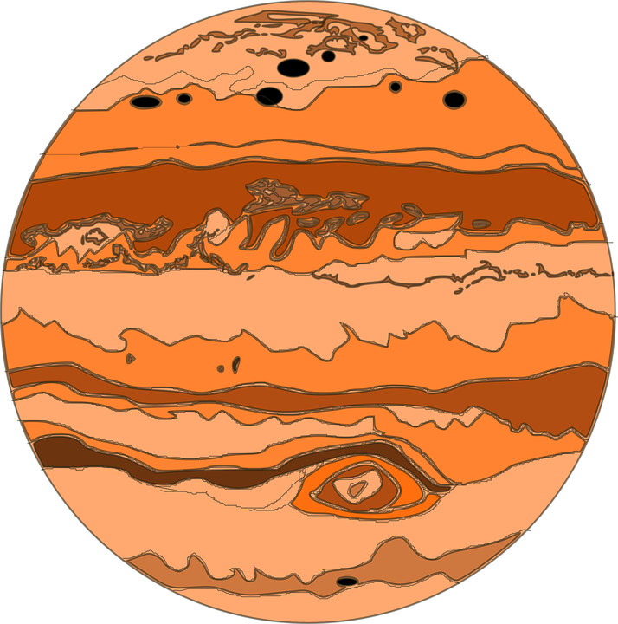
See the Mars
@IDK - CS Grads
YangYang Liu
Wenlu Wang
Ting Shen
Zhitao Gong

Slide 2
Naive Approach

Slide 3


Minimum Server
Serve static website.
Client side interacts with NASA server directly.

Slide 4
Limitations
Limited functionality
API request limits
No image cache

Slide 5
Improved Approach

Slide 6

Cache Server
Server
Python server,
Image processing,
Base64 encoding,
Image Cache
Client
Gallery.js, AJAX, Material design

Slide 7
Advantages
Easily extensible, e.g., filter, GIF.
Image cached at our server
API limits alleviated

Slide 8
Highlights
Clean UI
Query prefilter
Server cache
Image processing
Base64 encoding

Slide 9
“Design is not just what is looks like
and feels like. Design is how it works.”
- Steve Jobs

